Slide 1
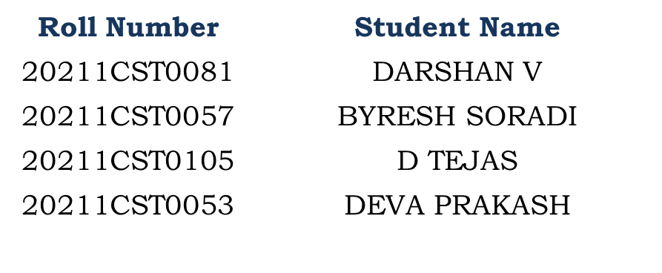
Customer support chatbot using Machine Learning
PIP2001 Capstone Project
Review-4
Batch Number:CST-G06
Under the Supervision of,
Dr. Madhusudhan M V
Professor-Selection Grade CSE
School of Computer Science and Engineering
Presidency University
Name of the Program: B.Tech Computer Science and Technology [Spl in AI & ML]
Name of the HoD: Dr. Saira Banu
Name of the Program Project Coordinator: Dr. Madhusudhan M V
Name of the School Project Coordinators: Dr. Sampath A K / Dr. Abdul Khadar A / Mr. Md Ziaur Rahman

Slide 2
Introduction
Chatbots, designed to mimic human conversation, are used in various applications like customer service and information retrieval. They function using natural language processing techniques, with simpler versions relying on keyword matching. Research focuses on developing machine learning-driven chatbots to improve customer satisfaction and reduce response times. The goal is to identify the most effective algorithms for enhancing customer support systems. Three main types of chatbots include rule-based, retrieval-based, and self-learning.

Slide 3
Literature Review
A machine learning based literature review notes the salient features of customer support chatbots. ELIZA (1966) and Parry (1972), were early chatbot systems, developed with rule-based mechanisms to provide predefined responses but they lacked the flexibility and scale. Chatbots have come a long way since then, and nowadays with advanced capabilities in natural language processing (NLP) and machine learning a chatbot is able to generate much more dynamic adaptive responses. These come under rule-based chatbots, retrieval-based and self-training for learnable chat bots with machine learning being the game changer making the processes very accurate in identifying queries and generating responses. According to the element or purpose you are using these types of models for, they include a kind like: sequence-to-sequence model — here is another one long-short-term memory networks and so on which will improve the conversation flow. Using NLP to analyse and understand human language has helped chatbot better even when it comes with challenge of understanding complex queries with contexts. Even companies with large pockets like Facebook and Google are having a tough time but they have made some inroads, there remain quite the roadblocks primarily due to data dependency among other things as outlined below: Subsequent research will center on multimodal inputs, and more sophisticated multilingual dialogue systems.

Slide 4
Existing method Drawback
The deployment of machine learning-based customer support chatbots face several limitations in their current form. Traditional rule-based systems, relying on predefined scripts, often struggle with complex and open-ended inquiries, leading to scalability and adaptability issues. Machine learning chatbots, while more advanced, require vast amounts of labeled data for effective training. The process of acquiring and curating such datasets is time-consuming and costly, and poor-quality data can diminish their performance.
Moreover, many ML-driven chatbots find it challenging to retain context over extended conversations, leading to disjointed responses and user frustration. Despite advancements in natural language processing (NLP), these chatbots still struggle with understanding natural human language, especially when users employ slang, colloquialisms, or ambiguous queries. This often results in incorrect or inadequate responses.
Developing self-learning chatbots also demands significant computational and financial resources, limiting their availability to larger enterprises. Additionally, current chatbots lack emotional intelligence, making it difficult for them to respond appropriately to users’ emotions. Security concerns also arise as chatbots handle sensitive information, making compliance with data protection regulations critical. Finally, multilingual support and the ability to handle complex queries still require significant improvements, often necessitating human intervention for advanced tasks.

Slide 5
Proposed Method
The improved chatbot system uses a neural network algorithm that is based on the LSTM, which is the Django's integrated part to give an accessible and interactive customer support experience to a proposed chatbot. The first step of the chatbot is to engage with the user who inputs a query or message via text and if necessary shares text together with short video clips. The neural network, through intent classification, plays a key role in the task of understanding and categorizing user queries. Intent classification is performed by means of the neural network that has been fed a set of responses to user questions, e.g. product inquiries, the bot can generate. It also employs a named entity recognition (NER) which is a technique to find important data such as product names, order numbers, and dates from user input.
The implemented chatbot model uses a sequence-to-sequence model equipped with an attention mechanism for generating responses that imbue the chatbot with the ability to respond in a very dynamic and human-like way. In the cases where the chatbot needs additional information to give an accurate response, it will link a database that retrieves relevant information based on the user’s query keywords or parameters. At the same time, the generated response is attached to the retrieved data so as to provide the user with a comprehensive and detailed explanation.
The performance of the system is measured using parameters such as accuracy, response time, and customer satisfaction, followed by feedback-based continuous improvement such as the inclusion of new behaviors and services. This feedback loop enables the system to learn and adapt over time in a bid to improve the user experience.

Slide 6
Objectives
The objective of a Customer Support Chatbot using Machine Learning is to enhance user experience and operational efficiency by providing timely and accurate assistance to customers. By utilizing advanced algorithms, such as neural networks and natural language processing (NLP), the chatbot aims to understand user queries, classify intents, and extract relevant information effectively. This enables the chatbot to address a wide range of customer inquiries, from product information to order tracking, with minimal human intervention.
Additionally, the chatbot seeks to reduce response times and improve accessibility by being available 24/7, thus allowing customers to receive immediate support regardless of time zones. Through continuous learning from customer interactions, the chatbot aims to adapt to evolving user preferences and emerging trends, ensuring relevance and accuracy in responses.
Furthermore, the system provides valuable insights into customer behavior and common queries, helping businesses optimize their support strategies and improve service delivery. By streamlining customer interactions and enhancing satisfaction, the ultimate goal is to foster customer loyalty and drive business growth, positioning the chatbot as a crucial component of a modern customer support framework.

Slide 7
Methodology/Modules
Using the Neural Network algorithm (LSTM) and Django consists of several interrelated modules that work together to ensure an efficient, responsive, and user-friendly experience. Below is an overview of the key modules involved in the chatbot's design and implementation:
1. Customer Engagement Module
This module initiates user interaction through a chatbot interface where customers can enter text queries or share images with accompanying text. This engagement is crucial for collecting user inputs and setting the stage for further processing.
2. Intent Classification Module
Leveraging the LSTM neural network, this module classifies user queries into predefined intents, such as "product inquiry" or "order status." Accurate intent classification is essential for understanding the user's needs and providing appropriate responses.
3. Entity Recognition Module
Utilizing Named Entity Recognition (NER), this module identifies and extracts significant entities from the user input, including product names, order numbers, dates, and other relevant data. This enhances the chatbot’s understanding of the context and specifics of the user’s inquiry.
4. Response Generation Module
Incorporating a Sequence-to-Sequence (Seq2Seq) model with attention mechanisms, this module generates dynamic and human-like responses based on the classified intent and extracted entities. The model processes the user's input as a sequence of words to produce coherent and contextually relevant replies.
5. Data Retrieval Module
When the chatbot encounters queries requiring additional information, this optional module connects to a database to retrieve relevant data. By analyzing keywords and parameters from the user's query, the chatbot enhances its responses with accurate and comprehensive information.
6. Response Integration Module
This module combines the generated responses with any retrieved data to present a clear and informative reply to the user. It ensures that the response effectively addresses the user's original query, enhancing overall user satisfaction.
7. Evaluation Metrics Module
The chatbot's performance is assessed through various metrics, including accuracy in intent recognition, response time, customer satisfaction ratings, and escalation rates to human agents. These metrics help evaluate the chatbot’s effectiveness and identify areas for improvement.
8. Continuous Learning Module
This module gathers customer feedback to regularly update the chatbot’s models. By analyzing new user behaviors, trends, and service requirements, the chatbot evolves over time, maintaining its relevance and improving its accuracy and efficiency.
Conclusion
These modules work collaboratively to create a robust customer support chatbot that utilizes machine learning for intelligent interactions, ensuring a seamless user experience while continuously learning and adapting to meet user needs. By implementing this methodology, businesses can improve customer satisfaction, streamline operations, and drive engagement through effective support solutions.

Slide 8
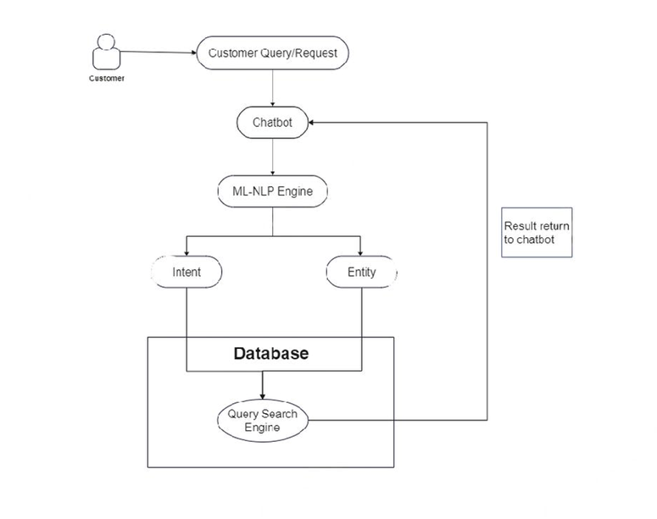
Architecture

Slide 9
Hardware/software components
Implementing a customer support chatbot using machine learning involves a combination of hardware and software components. Here’s an overview of both:
Hardware Components
Computing Resources:
GPUs/CPUs: High-performance processors for training machine learning models. GPUs are particularly beneficial for deep learning tasks.
Storage:
Database Storage: For storing user data, chat logs, and model parameters. Options include SQL databases (like PostgreSQL) and NoSQL databases (like MongoDB).
Backup Systems: To ensure data redundancy and recovery.
Networking Equipment:
Routers/Switches: Reliable network hardware to facilitate communication between servers and clients.
User Devices:
Client Devices: Laptops, smartphones, and tablets through which users interact with the chatbot.
Software Components
Frameworks and Libraries:
Machine Learning Libraries: TensorFlow, PyTorch, or Keras for developing machine learning models.
Natural Language Processing (NLP) Libraries: NLTK, SpaCy, or Hugging Face's Transformers for intent classification and entity recognition.
Web Frameworks:
Django/Flask: For building the backend of the chatbot and managing user interactions.
Frontend Frameworks: React, Angular, or Vue.js for developing user interfaces.
Database Management Systems:
Relational Databases: MySQL or PostgreSQL for structured data storage.
NoSQL Databases: MongoDB or Firebase for handling unstructured data.
APIs:
RESTful APIs: For communication between the chatbot and external services or databases.
Third-Party APIs: Services for additional functionalities, such as payment processing or CRM integration.

Slide 10
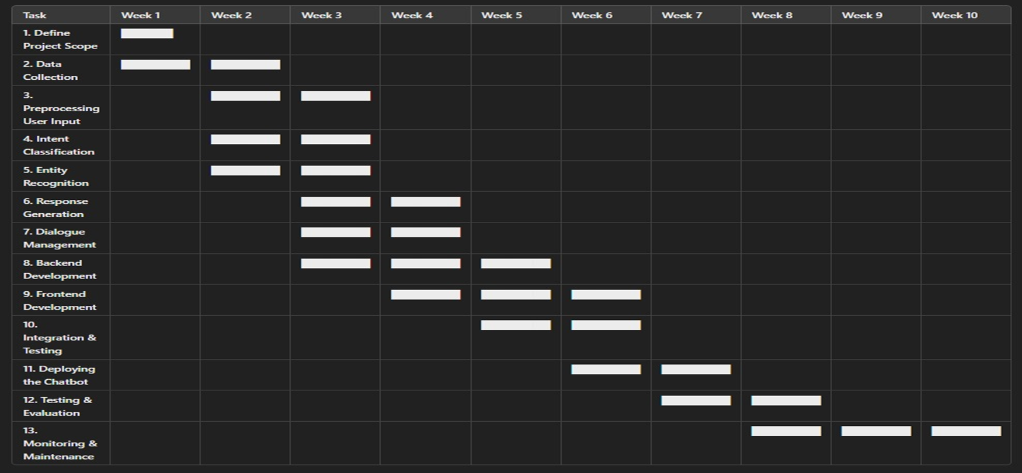
Timeline of Project

Slide 11
Expected Outcomes
The expected outcomes from implementing a Customer Support Chatbot using Machine Learning are multifaceted and impactful. Firstly, the chatbot is anticipated to enhance customer engagement by providing instant, 24/7 support, allowing users to get immediate responses to their queries. This improves customer satisfaction and reduces wait times, leading to a more positive user experience.
Secondly, the accuracy of intent recognition and entity extraction is expected to increase significantly, resulting in more relevant and precise responses. This minimizes the likelihood of miscommunication and ensures customers receive the information they seek efficiently. By utilizing continuous learning mechanisms, the chatbot can adapt to evolving user behaviors and preferences, further improving its effectiveness over time.
Additionally, the implementation of this chatbot can lead to operational cost savings for the organization by reducing the reliance on human agents for routine inquiries. The escalation rate of queries requiring human intervention is expected to decrease as the chatbot handles more inquiries independently.
Ultimately, the integration of a machine learning-based chatbot is projected to contribute to better data-driven insights for the business, enhancing decision-making and strategic planning while fostering stronger customer relationships through improved service delivery.

Slide 12
Conclusion
The success of a chatbot system designed for customer support, by leveraging machine learning models, can be emphasized in this paper. The advancement in NLP techniques, coupled with intent recognition and sentiment analysis, ensures timely, correct, and personalized answers to a customer's queries. It uses continuous learning for following changing needs and behaviour of customers, thus providing a scalable and efficient means for modern businesses. Future research could be conducted with multilingual inputs such as images and voice and increasing conversations in depth by advanced dialog systems.

Slide 13
Github Link
The Github link provided should have public access permission.
Github Link:-darshanv81/Customer-support-chatbot-using-Machine-Learning · GitHub

Slide 14
References
Weizenbaum, J. (1966). ELIZA: A program designed to study human-machine communication through natural language. Communications of the ACM, 9(1), 36-45.
Selvi, V., Saranya, S., Chidida, K., & Abarna, R. (2019). Chatbot and bully-free chat. In Proceedings of the International Conference on Systems Computation, Automation, and Networking.
Keikha, M., Park, J.H., Croft, W.B., & Sanderson, M. (2014). Retrieving passages and finding answers. In Proceedings of the Australasian Document Computing Symposium, 81–84.
Adar, E., Teevan, J., Dumais, S.T., and Elsas, J.L. The web changes everything. Proc. WSDM '09, (2009).
Yan, R.; Song, Y.; Wu, H. Learning to Respond with Deep Neural Networks for Retrieval-Based Human-Computer Conversation System. In Proceedings of the 39th International ACM SIGIR Conference on Research and Development in Information Retrieval-SIGIR ’16, Pisa, Italy, 17–21July 2016; ACM Press: Pisa, Italy, 2016; pp. 55–64.

Slide 15
Project work mapping with SDG
A customer support chatbot using ML can potentially contribute to several Sustainable Development Goals (SDGs). Here are a few relevant ones:
8. Decent Work and Economic Growth
Increased efficiency: Chatbots can streamline customer support processes, reducing the workload on human agents and potentially leading to increased productivity.
Job creation: While chatbots can automate certain tasks, they may also create new jobs in areas like chatbot development, maintenance, and data analysis.
9. Industry, Innovation, and Infrastructure
Technological advancement: The development and implementation of AI-powered chatbots contribute to technological advancements in the field of customer service.
11. Sustainable Cities and Communities
Improved accessibility: Chatbots can provide 24/7 support, making services more accessible to residents in cities.
Reduced environmental impact: By reducing the need for physical customer service centers, chatbots can contribute to a more sustainable urban environment.
12. Responsible Consumption and Production
Resource efficiency: Chatbots can help optimize customer service operations, reducing waste and improving resource efficiency.
13. Climate Action
Reduced carbon footprint: By reducing the need for physical travel to customer service centers, chatbots can contribute to lower carbon emissions.

Slide 16
Thank You

